Slide 1
JPA Ecommerce Project

Slide 2
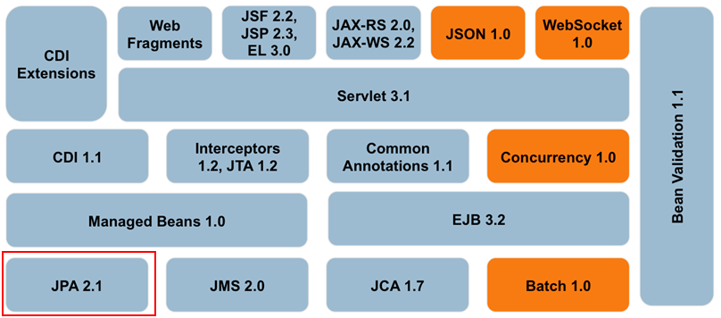
What is Java Persistence API
JPA is the Object-Relational Mapping (ORM) and Persistence Management technology of the Java Enterprise Edition platform.
Notes:
This is JEE Version 7

Slide 3
JPA Features
POJO Persistence : The framework provides for the persistence of Plain Old Java Objects.
Annotation-based Configuration of Object-Relational Mapping.
Annotations placed in entity classes describe the mapping of classes to tables, attributes to columns, associations to FK relations, etc.
Can generation schema from annotated Entity classes.
Implements standard OOAD associations with FK relations.
One-One / One-Many / Many-Many associations are automatically translated to FK relations.
Extended Query Language: ORM substitution for SQL.
Notes:
Plain Old Java Objects

Slide 4
JPA and Hibernate
Hibernate is a successful ORM technology that pre-dates the JPA standards.
Hibernate’s success motivated the shift from the older and much hated JEE Entity Beans.
JPA is a standard and API which is closely modeled after Hibernate’s original design.
We will be working with Hibernate’s implementation of JPA.
There are several other implementations e.g. EclipseLink ^{(1),} Apache OpenJPA, Oracle TopLink, and others ⁽²⁾.
Notes:
1 - See https://en.wikipedia.org/wiki/Java_Persistence_API
2 = In 2016 on survey has Hibernate JPA used by 72% of the respondents followed by 13% for EclipseLink.

Slide 5
JPA Major Components
EntityManager: A class that is the interface to JPA services.
Permits the CRUD of entity object instances.
Performs Transaction Management.
Executes JPA Query Language (JPQL) and Standard SQL stmts.
Several other less important services.
JPA Annotations
JPA Annotations embedded in to entity classes to be persisted.
Describes the mapping of classes to tables.
Describes the associations between entities i.e. 1-1, 1-N, N-M, etc.
Describes relational constraints such as UNIQUE, etc.

Slide 6
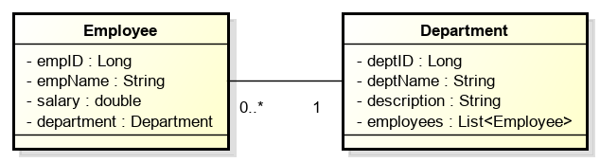
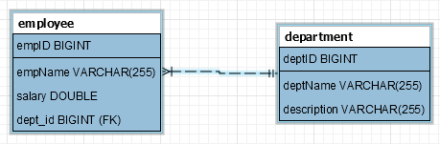
Example OR Mapping
Employee OOAD & ERD
Note the bi-directional relationship between Employee and Department.
See archived project hibernateSampleCode2.zip.

Slide 7
Entity-Class Annotations From project hibernateSampleCode2
The entity class (Department.java) uses JPA annotations to mark the class as a persistent entity.
@Entity
@Table(name = "department")
public class Department
{
private Long deptId;
…
The @Entity annotation signifies that the class is persistent.
The @Table annotation names the table and is optional.
The same @Entity annotations are found in the Employee entity class.

Slide 8
Primary Key Annotations
Entity class attributes are annotated to describe them as IDs (primary keys) and their associations with other entities.
@Id
@GeneratedValue(strategy = GenerationType.IDENTITY)
Private Long deptId;
@Id annotation marks the attribute as the entity’s primary key.
@GeneratedValue annotation signifies that the key will be generated by the DBMS i.e. auto-increment column.

Slide 9
@Column Annotation
@Column, is put on a variable.
Describes the mapping of the attribute to the table column.
Has several options:
Name is the generated table name.
Nullable determines the nullability of the generated attribute.
Length determines the length of the VARCHAR attribute.

Slide 10
@Column Annotation
The @Column annotation is not needed if the default mapping of class attribute to table column is sufficient.
The auto-generated schema will generate tables columns.
Notice that no annotations are used in the example.
In most cases, the default OR mapping is sufficient for non-referencing attributes i.e. primitive types and Strings.
This is why only the Employee and Department reference variable are annotated in the example code.
In other cases, we need to identify optional parameters to get the mapping semantics needed by the requirements.
VARCHAR lengths, notnull, etc.

Slide 11
Associations
There are 4 types of supported associations:
@OneToOne
@OneToMany
@ManyToOne
@ManyToMany
Both one-way and bi-directional navigation can be supported across 1-1, 1-N, & N-1 associations.
Association fetch type can be defined as Lazy and Eager
AKA “Loading Strategy”.

Slide 12
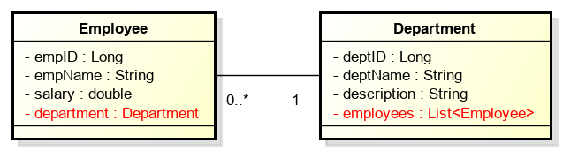
Bi-Directional Navigation Between Employee and Department
Employee and Department share 1-N bi-directional navigation.
Employees can reach their Department
Departments maintain a collection of their Employees.
The model supports bi-directional association with …
The Department reference variable in Employee.
The List<Employee> references in Department.

Slide 13
Employee To Department Association
Many Employees belong to a single Department.
The ManyToOne annotation in Employee implements the association from many Employee to one Department.
public class Employee { …
@ManyToOne(fetch=FetchType.EAGER)
@JoinColumn(name="dept_id", unique=false)
public Department getDepartment(){ …
The name argument names the dept_id column to be added to the Employee table implementing the foreign key with Department.
See Employee.java in hibernateSampleCode2 project.

Slide 14
Department To Employee Association
Department maintains a List of its Employee references.
public class Department { …
@OneToMany(fetch=FetchType.LAZY, mappedBy="department")
public List<Employee> getEmployees() { …
The mappedBy argument names the collection on the opposite side of the relationship e.g. Employee.department.
See Department.java in hibernateSampleCode2 project.
Note: The bi-directional navigation between Employee & Department is implemented by a single Foreign Key (dept_id) on Employee.

Slide 15
Association FetchType
The fetch attribute describes when associated objects will be retrieved from the database.
FetchType.EAGER will cause the associated objects to be retrieved from the DB when the owning object is retrieved .
When retrieving an Employee from the database, its associated Department will also be retrieved.
FetchType.LAZY will cause the associated objects to be retrieved from the DB when referenced from the retrieved object i.e. on demand.
When retrieving a Department from the database, its collection of Employees will be copied on demand as the collection is accessed.
FetchType.LAZY is used to reduce the overhead of retrieving a large number of objects when fetching the owning object.

Slide 16
Ecommerce JPA Project
The following classes have been provided in the student development project.
See next slide.
The main difference between the JPA and JDBC projects is the use of Customer instance references in the classes Address and CreditCard.
JDBC project used address and credit card IDs, not references.

Slide 17
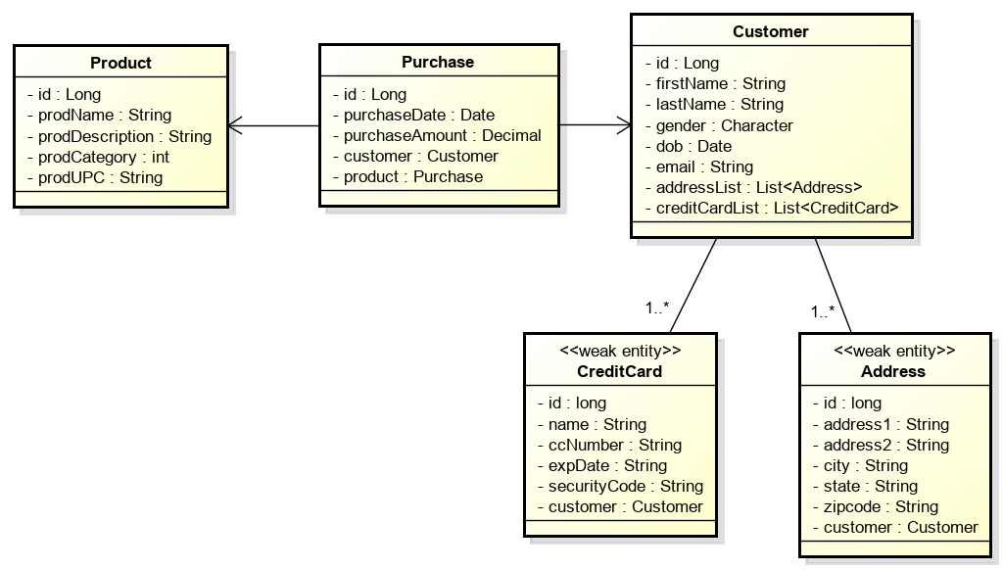
Ecommerce JPA Project Entity Classes

Slide 18
Ecommerce Entity Class JPA Annotations
Every entity class must annotate the class declaration and its primary key getter method.
For example, the Customer class …
Annotate the class declaration
@Entity
@Table(name = “customer")
public class Customer {}
Annotate the primary key attribute.
@Id
@GeneratedValue(strategy = GenerationType.IDENTITY)
public Long id

Slide 19
Ecommerce Entity Association Annotations
The JPA project schema maintains 1-N associations between Customer to Address and Customer to CreditCard.
The List attributes on the “owning” side of a N-1 relationship needs to be annotated OneToMany.
On the owning Customer class.
@OneToMany(fetch = FetchType.EAGER, cascade = CascadeType.ALL)
@OrderColumn
private List<Address> addressList;
@ OneToMany(fetch = FetchType.EAGER, cascade = CascadeType.ALL)
private List<CreditCard> creditCardList;

Slide 20
Ecommerce Entity Association Annotations
The attributes on the “owned” side of a N-1 relationship needs to be annotated ManyToOne.
On the owned Address class.
@ManyToOne(fetch=FetchType.EAGER)
@JoinColumn(name="cid", unique=false) // FK column to be generated.
private Customer customer;
On the owned CreditCard class.
@ManyToOne(fetch=FetchType.EAGER)
@JoinColumn(name="cid", unique=false) // FK column to be generated.
private Customer customer;

Slide 21
JPA-Project Associations
Two associations between Purchase to Product and Purchase to Customer.
Implemented as two 1-1 annotated references on Purchase.
In the owning Purchase class …
@OneToOne(fetch = FetchType.EAGER)
private Customer customer;
@OneToOne(fetch = FetchType.EAGER)
private Product product;
There are no annotated references on the class Product.

Slide 22
Configuring JPA
A configuration file “persistence.xml” is used to describe the persistence for an application.
persistence-unit is the XML element that described a the connection, classes, etc. typically for an application.
The persistence-unit describes:
The DBMS connection.
Entities to be persisted.
Other configuration information.

Slide 23
Persistence.xml
Persistence Unit Name
JDBC Connection URL
DBMS ID & Password
<persistence-unit name="jpa-employee" transaction-type="RESOURCE_LOCAL">
<provider>org.hibernate.jpa.HibernatePersistenceProvider</provider>
<properties>
<property name="javax.persistence.jdbc.url" value="jdbc:mysql://localhost/employee" />
<property name="javax.persistence.jdbc.user" value="root" />
<property name="javax.persistence.jdbc.password" value=“xxx" />
<property name="javax.persistence.jdbc.driver" value="com.mysql.jdbc.Driver" />
<property name="hibernate.show_sql" value="false" />
<property name="hibernate.format_sql" value="true" />
<property name="hibernate.dialect" value="org.hibernate.dialect.MySQL5InnoDBDialect" />
<property name="hibernate.hbm2ddl.auto" value="update" />
<property name="hibernate.archive.autodetection" value="class, hbm" />
<!-- Configuring Connection Pool -->
<property name="hibernate.c3p0.min_size" value="5" />
<property name="hibernate.c3p0.max_size" value="20" />
<property name="hibernate.c3p0.timeout" value="500" />
<property name="hibernate.c3p0.max_statements" value="50" />
<property name="hibernate.c3p0.idle_test_period" value="2000" />
</properties>
</persistence-unit>
Debug Options
Schema Generation
Enable Annotations

Slide 24
Persistence Options
JPA / Hibernate can automatically generate and update a DBMS schema that supports the OR Mapping described by the application’s entity classes.
hibernate.hbm2ddl.auto configures DDL generation.
Hibernate will create the tables, but can not create the initial schema.
Various debugging options are provided.
Integration with logging libraries with multiple levels of detail.
hibernate.show_sql will print the SQL executed on the DBMS.

Slide 25
Entity Manager
EntityManager is the central controller class for CRUD objects in JPA.
Many of the services found in JDBC Connection, and much more.
EntityManager is not thread safe.
Responsible for persisting and finding managed entity objects.
Manages transactions.
Executes JPQL statements.

Slide 26
Entity Manager
Persistence Unit
A unit of persistence including database connection and the entity classes that can be persisted.
One or more persistence units are defined in a persistence.xml configuration file.
EntityManagerFactory
The EntityManagerFactory creates EntityManagers.
Each EMF is initialized with a PersistenceUnit.
Typically, an application maintains a single EMF.

Slide 27
EntityManager Methods
Create, commit, and rollback transactions
EM.getTransaction.begin()
EM.getTransaction.commit()
EM.getTransaction.rollback()
EM.persist(Object) where object is the unattached object to be persisted in the DBMS.
EM.find(Class, IDValue) where class is the entity’s class and id is the value of the entity’s ID attribute value.
EM.merge(Object) will merge a ‘detached’ object back into a persistence context i.e. associated with a table row.
EM.remove(Object) where object’s id value will be used to remove the entity from the DBMS.

Slide 28
Example: Create (Persist) Customer
public void create(EntityManagerFactory emf) {
// Obtain EntityManger
EnityManager em = emf.createEntityManager();
// Build Entity To Persist
Customer cust = new Customer();
cust.setName("Jonny Quest");
cust.setDOB("2/21/1955");
// Start Transaction
em.getTransaction().begin();
// Persist the customer
em.persist(cust);
// Commit Transaction
em.getTransaction().commit();
// Close EntityManager
em.close();
}

Slide 29
Example: Retrieve Customer by ID
public void retrieve(EntityManagerFactory emf) {
// Obtain EntityManger
EnityManager em = emf.createEntityManager();
// Start Transaction
em.getTransaction().begin();
// Find Customer by ID
long id = 1;
Customer cust = (Customer)em.find(Customer.class, id);
System.out.println("Customer Name " + cust.getName());
// Commit Transaction
em.getTransaction().commit();
// Close EM
em.close();
}

Slide 30
Example: Update Customer
public void update(EntityManagerFactory emf) {
// Obtain EntityManger
EnityManager em = emf.createEntityManager();
// Start Transaction
em.getTransaction().begin();
// Find Customer by ID
Customer cust = (Customer)em.find(Customer.class, 1);
// Update the entity state
cust.setDOB("2/21/1956");
// New state is persisted when transaction is committed.
em.getTransaction().commit();
// Close EM
em.close();
}

Slide 31
Example: Delete Customer
public void delete(EntityManagerFactory emf) {
// Obtain EntityManger
EnityManager em = emf.createEntityManager();
// Start Transaction
em.getTransaction().begin();
// Find Customer by ID
Customer cust = (Customer)em.find(Customer.class, 1);
// Delete the customer
em.remove(cust)
// Commit Transaction
em.getTransaction().commit();
// Close EM
em.close();
}

Slide 32
JPA Ecommerce Services
The design of JPA persistence services uses a EntityManager passed in the service class constructor.
See any of the service implementation classes.
The method CustomerPersistenceService.create(Customer) is an example of how services use the EntityManager.
public void create(Customer cust) throws DAOException, SQLException {
try {
em.getTransaction().begin();
em.persist(cust);
em.getTransaction().commit();
}
catch (Exception ex) {
em.getTransaction().rollback();
throw ex;
}
}

Slide 33
Java Persistence Query Language
JPA provides its own Data Manipulation Language substitute for SQL.
JPQL is a query language that is used to define select and joins between entities (tables).
JPQL only supports querying data, not updated, etc.
Unlike SQL, JPQL describes its queries in terms of object attributes (not table columns).
See JPQL Docs
Notes:
Note that UTD engineering school students have access to O’Reilly Safari Online Library.
Their book on JPA/Hibernate is very good.

Slide 34
JPQL Features
JPQL provides most of the facilities offered by SQL.
A SELECT clause, which determines the type of the objects and values to be selected from the objects.
A FROM clause, which provides declarations that designate the class to which the expressions specified in the other clauses of the query apply.
An optional WHERE clause, which may be used to restrict the results that are returned by the query;
An optional GROUP BY clause, which allows query results to be aggregated in terms of groups;
An optional HAVING clause, which allows filtering over aggregated groups;
An optional ORDER BY clause, which may be used to order the results that are returned by the query.

Slide 35
JPQL Expressions
Select Customers by Zipcode:
select from Customer as c where c.address.zipcode = :zip
Select Purchases made by Customer:
select from Purchase as p where p.customer.id = :customerID
Select Purchases made between two dates:
select from Purchase as p where p.purchaseDate between :start and :end
Select customers whose addresses lie in a zipcode.
select c from Customer c inner join c.addressList a where a.zipcode = :zip
Note that these queries select and join by Java class attributes, not table columns.

Slide 36
Executing JPQL expressions
The JPA EntityManager provides a createQuery() method that is passed the JPQL query string.
public List<Customer> retrieveByZipCode(String zipCode) throws SQLException
{
List<Customer> customers = entityManager.createQuery( “select from Customer as c where c.address.zipcode = :zip")
.setParameter("zip", zipCode)
.getResultList();
return customers;
}
Note the API is defined so that these three operations can be chained into a single compound statement.

Slide 37
JPQL Fun Facts
Supports inner and outer joins.
Uses LIKE to specify regex-like String matches.
Allows subqueries with IN, ANY, ALL, and other inclusion mechanisms.
Provides GROUP BY, ORDER BY, and HAVING.
Aggregate Functions: MIN, MAX, AVG, etc.
Other features provided by SQL.

Slide 38
Entity Management
Persistence Context
A context for holding persistent entity objects.
Each EntityManager maintains a single Persistence Context.
The EntityManager maintains (caches) persistent entities retrieved form the database.
If the same entity is fetched twice from the same EntityManager, the same instance (identity) will be returned.
If the same entity is fetched twice from the different EntityManager, two different instances (identity) will be returned.
The EM Persistence Context is cleared when the EM is closed.

Slide 39
Entity Object Lifecycle
The lifecycle of persisted objects consists of four states: New, Managed, Removed and Detached. See next slide.
A New Object has been created but not persisted.
A Managed Object has been persisted i.e. has a row in the table.
A Detached Objects is a persisted object that has been disconnected from its Persistence Context.
The Persistence Context is lost when the Transaction is committed / rolled-back¹or the EntityManager instance is closed.
A Removed Object has been marked for removal and will be deleted from the DBMS when the change is committed.
Notes:
1. See notes on next slide.

Slide 40
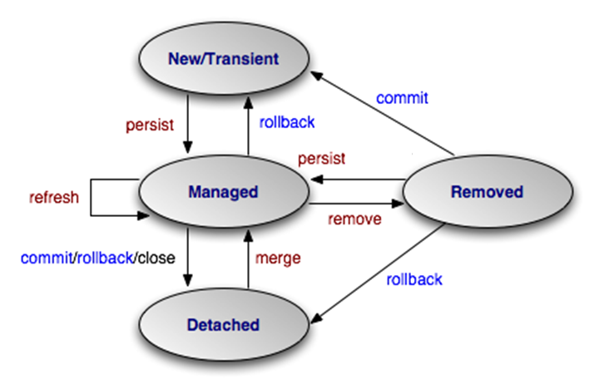
Managed-Entity-Object States

Slide 41
Detached Entities
A Managed Entity is attached to the database.
Its state reflects the current state of its entity table row.
Lazy-fetched associations will be retrieved on-access.
A Managed Entity becomes Detached when its transaction is committed / rolled-back or its Entity Manager is closed.
Its state is detached from the state of its entity table row.
Lazy-fetched associations will generate an error on-access.
A Detached Entity can be reattached to the database using the EM.merge() method.

Slide 42
Steps to Implement JPA Project See Project Description Document
Install Three Provided JPA (Hibernate) Projects
Customize persistence.xml
Update with DBMS Connection Information
Create Empty Schema in Database
Tables, but not schema, will be generated by JPA
Add JPA Annotations to Provided Entity Classes
Execute PopulateTables application
Verify tables built and rows added.
Implement Three Services (No DAOs)
Test Service Implementation with Provided Junit test cases.

